Slide 1
Data exploration and client-side analytics in a custom 2D web app
Dev Summit 2020 Plenary Session
Kristian Ekenes

Slide 2
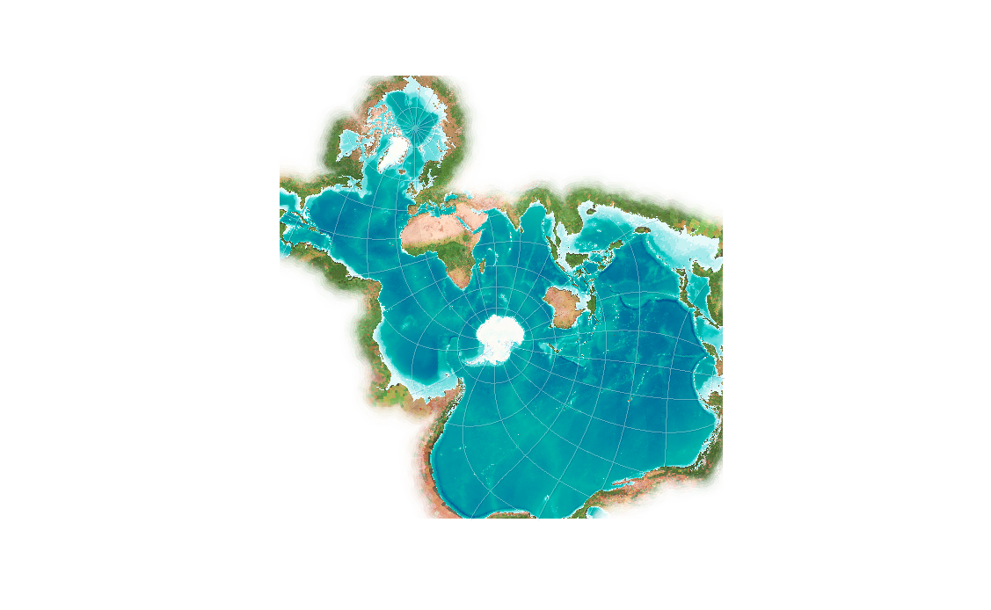
Because of the recent enhancements Jeremy described to bring more data to the browser efficiently, we can use the JS API to build highly interactive custom data exploration applications for the web.
In a couple of weeks the JS API will add support for rendering data in the Spilhaus projection, a conformal projection that depicts the world’s ocean as a single body of water. This makes it an ideal choice for exploring oceanic data.

Slide 3
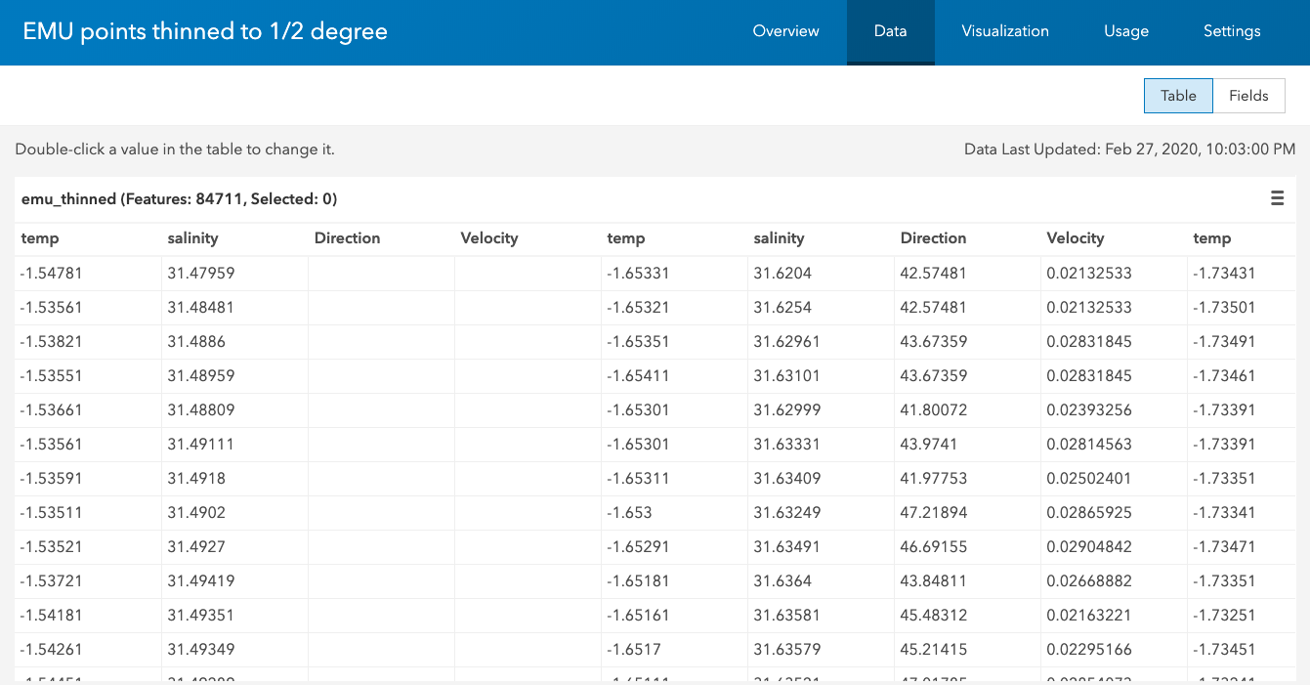
Each row in our dataset indicates the x,y location of of sample point, and each column represents a temperature or salinity value at various depths for the given point. This results in a massive table containing hundreds of columns.

Slide 4
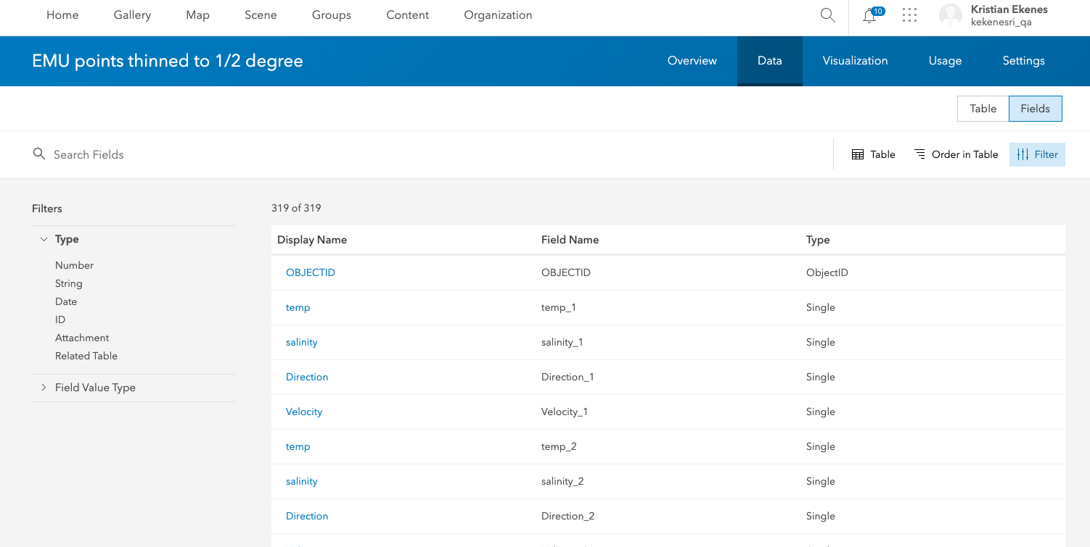
Fields view of the data showing the hundreds of columns in the layer.

Slide 5
In this app I download and display the open ecological marine unit data provided by Esri, to explore some temperature and salinity using sample points in the world’s oceans.
This is not a tile layer or an image.
[hover pointer over the points]
this is a feature layer I’ve styled with a continuous color renderer to visualize salinity. As the user moves the cursor over each point, I execute a client-side query and render the results in the scatter plot to the left to view how salinity varies at each point at various depths of the ocean. We can achieve this fast performance because the query executes against our client-side query engine.

Slide 6
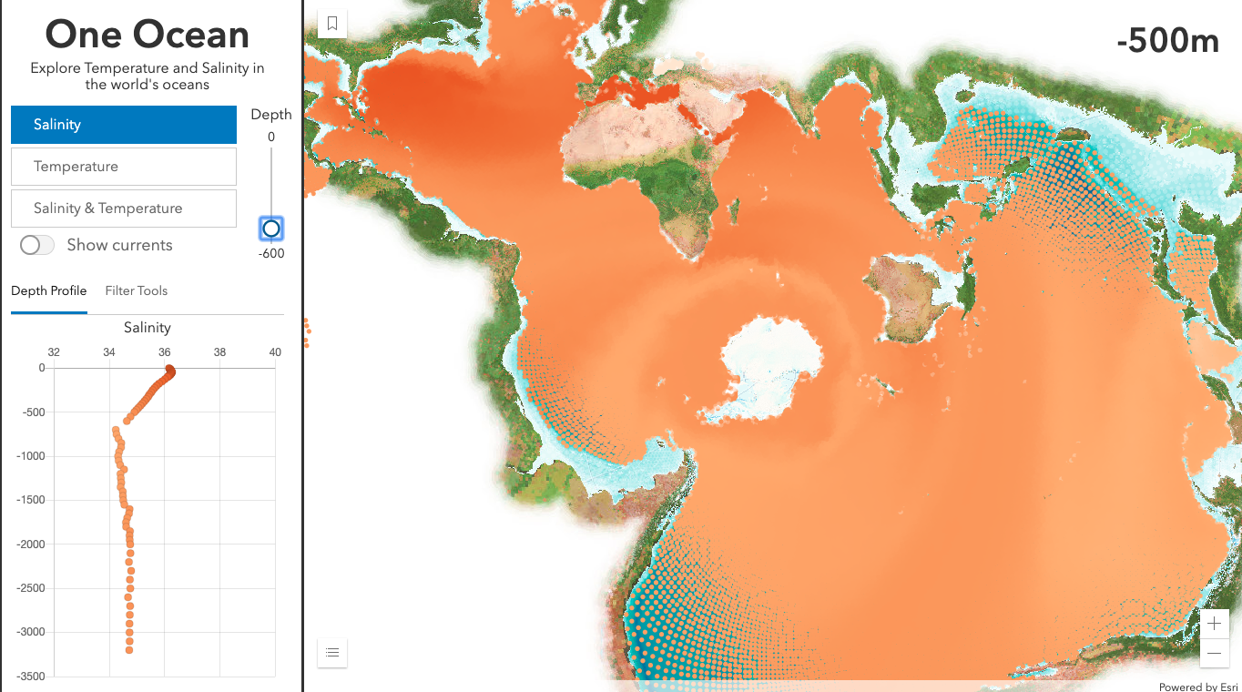
[Move the depth slider]
I’ve also configured a vertical slider to allow the user to update the renderer to point to salinity values for a particular depth.
This may look like an update to the color ramp, or a client-side filter, but none of those things are happening. Instead I’m changing the field name. Since the data for all these fields already exists on a texture in the GPU, we can update the visualization without having to reprocess the geometries.

Slide 7
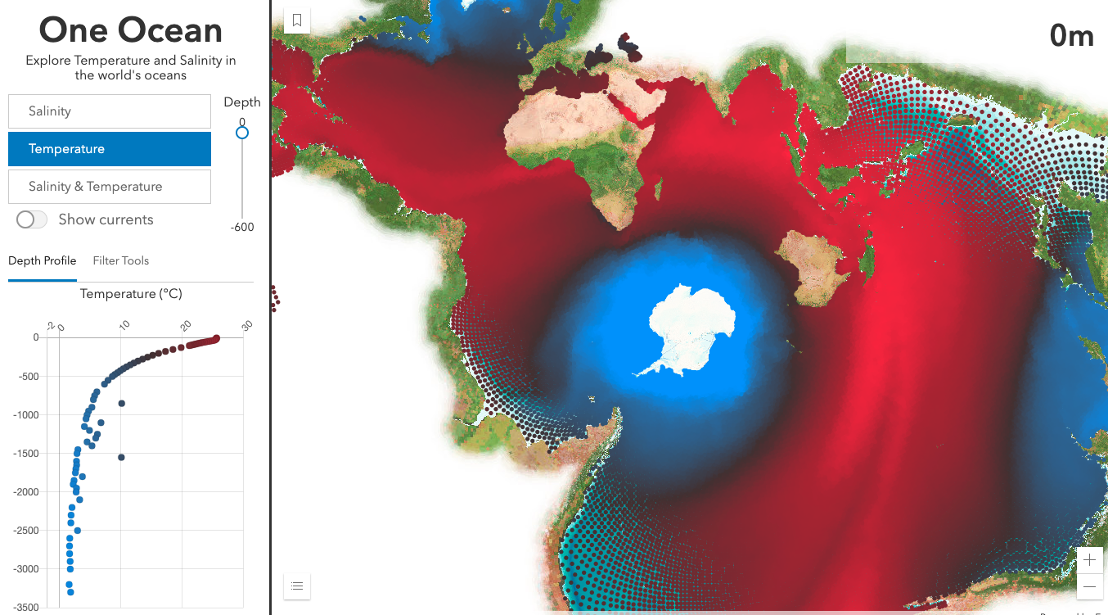
[switch to temp]
Even when I switch variables – say to temperature – The renderer handles the updates very quickly without noticeable flashing.

Slide 8
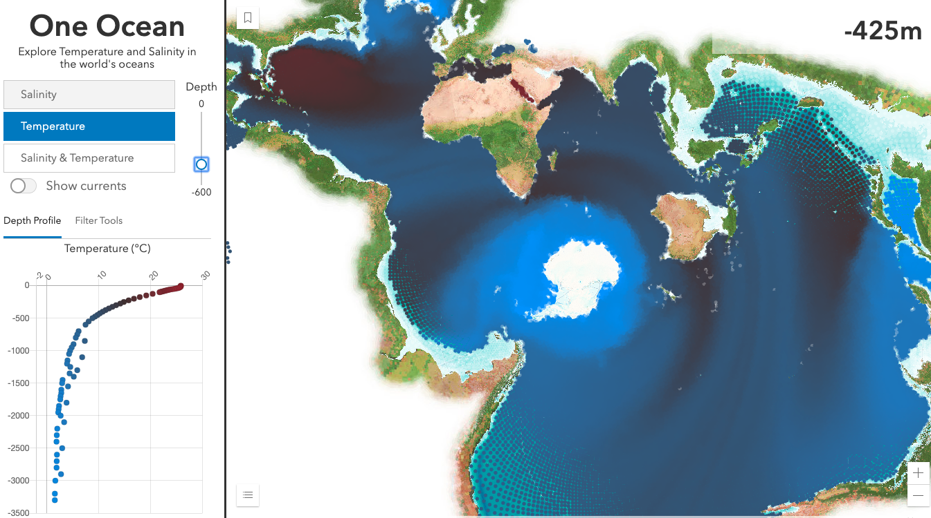
[use depth slider]

Slide 9
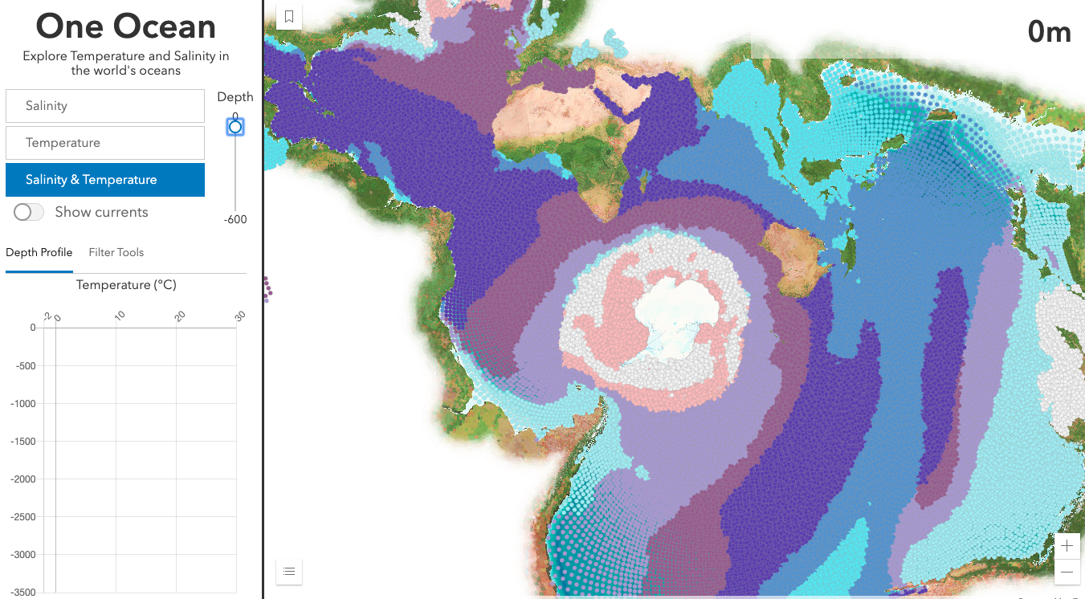
[switch to relationship]
[Make sure legend is visible]
We can see a relationship between these two variables on the surface using the relationship renderer. As we go down in depth, the relationship is much weaker as both variables become more homogenous throughout the world.

Slide 10
This layer contains two additional variables – direction and velocity – that can be used to view ocean currents in relation to this data.
I’ll use a size visual variable to indicate the speed of the current at each location, and a rotation variable to indicate the direction of the flow.
Since a circle isn’t suited for mapping direction, I’ll need a different symbol type.

Slide 11
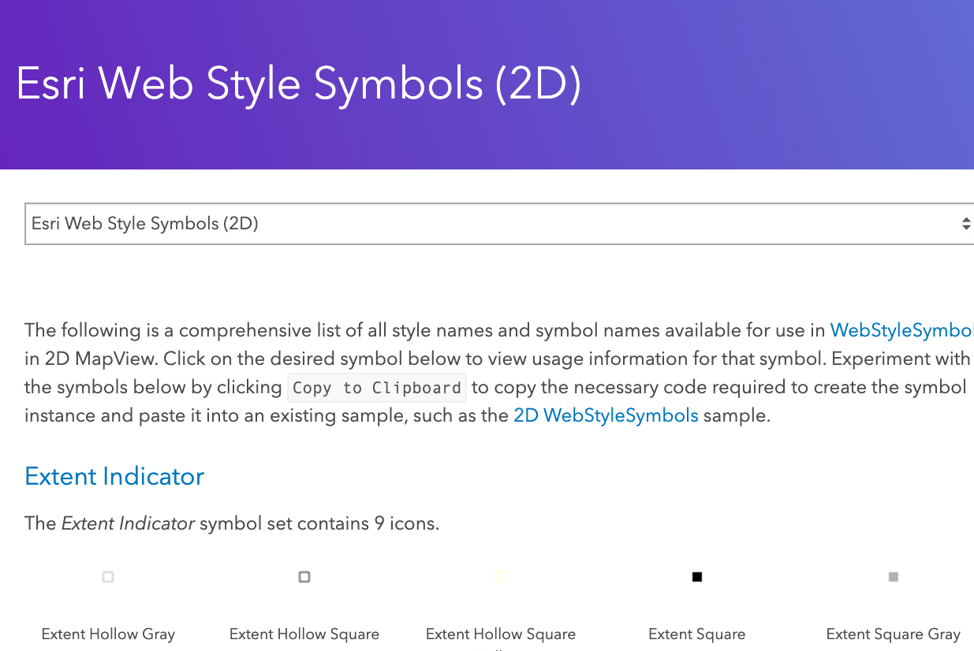
The Esri JS API has hundreds of scalable, multi-layer, vector symbols – known as web styles – readily available for use in the JS API. You can see a preview of these symbols on the Esri 2D web styles page, view the code, and copy and paste it directly into your application.

Slide 12
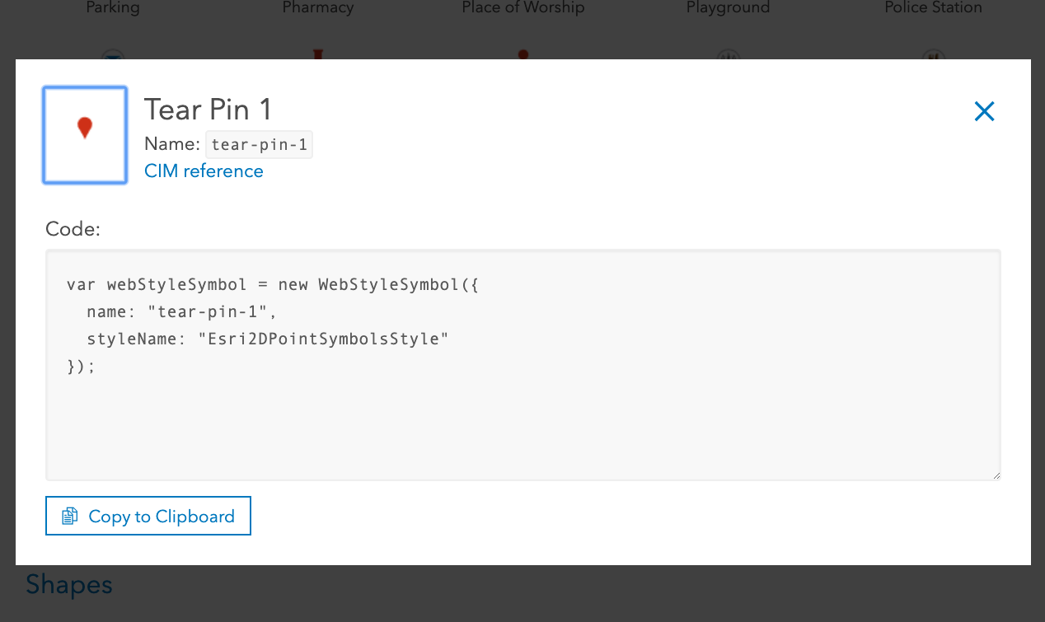
I chose to use the Tear Pin symbol since it resembles a drop of water.
By clicking on the preview, you get a snippet that you can simply copy and paste into your code.

Slide 13
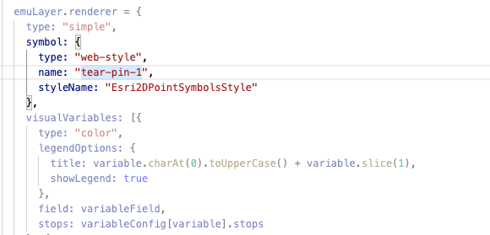
Here I’ve referenced the web style symbol in my renderer

Slide 14
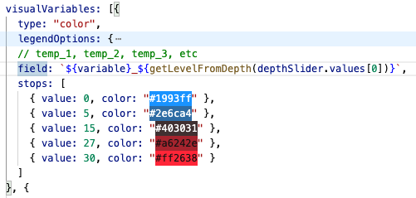
The field referenced by each visual variable is updated based on a slider value. Note the color values and data ranges remain constant, so the GPU can look up to a new data value without reprocessing the geometries.

Slide 15
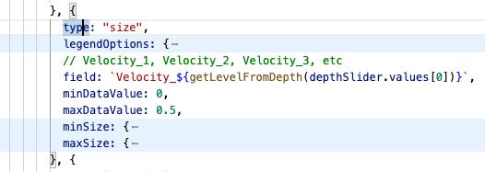
Similarly I update the size of each icon based on the corresponding value in the Velocity field for the given depth.
But this variable is slightly different…

Slide 16
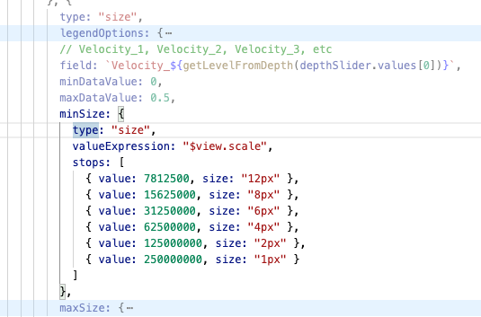
Instead of assigning a fixed size to the ranges, I can vary symbol size not only by data value, but by scale using an Arcade expression.

Slide 17
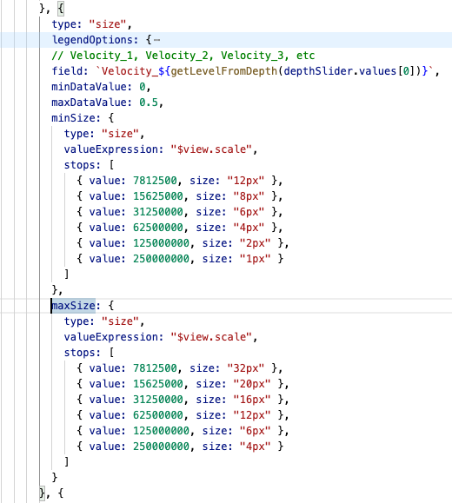
So I can ensure the icons are visible and easily understood by the user as they zoom in and out.

Slide 18
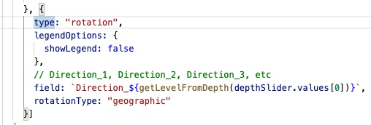
Finally, I set a rotation visual variable and set it to the appropriate direction field based on the selected depth value.
This renderer will update every time the user moves the depth slider and switches the selected variable.

Slide 19
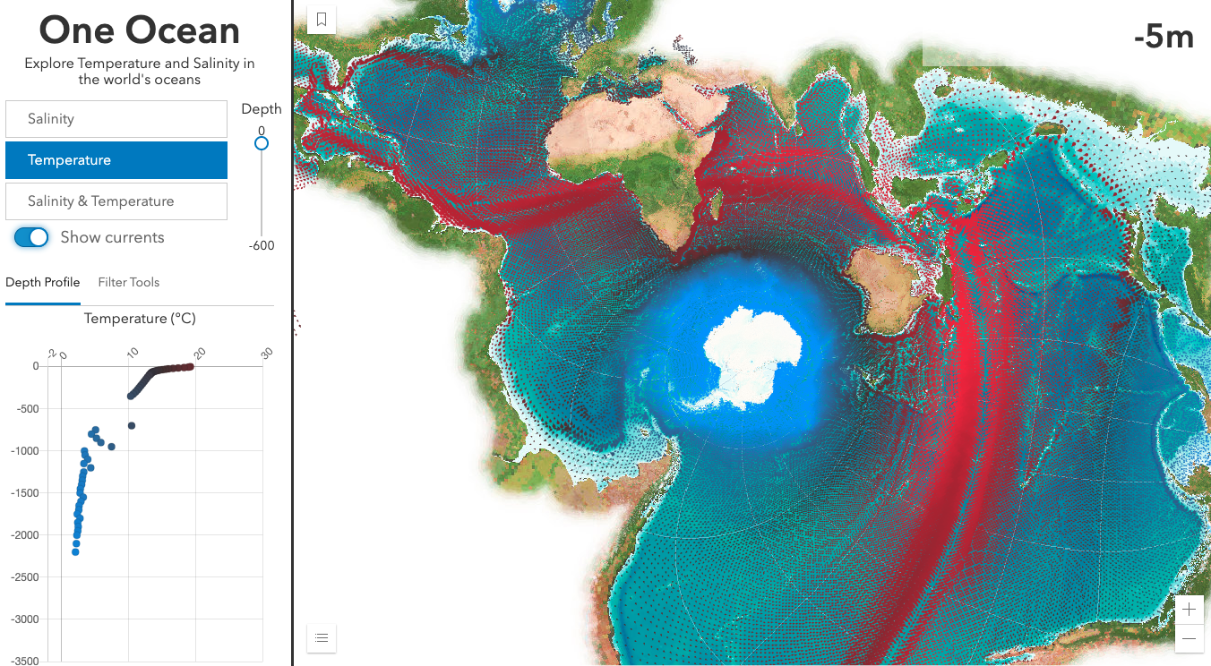
[Toggle show currents]
When I toggle the “show currents” switch, the new size and rotation variables are applied to the renderer and I can immediately see patterns of strong currents, where they are warm, etc.
Since this is a conformal projection, direction is preserved so we’re actually viewing the correct angles of the ocean currents as they exist in the real world.

Slide 20
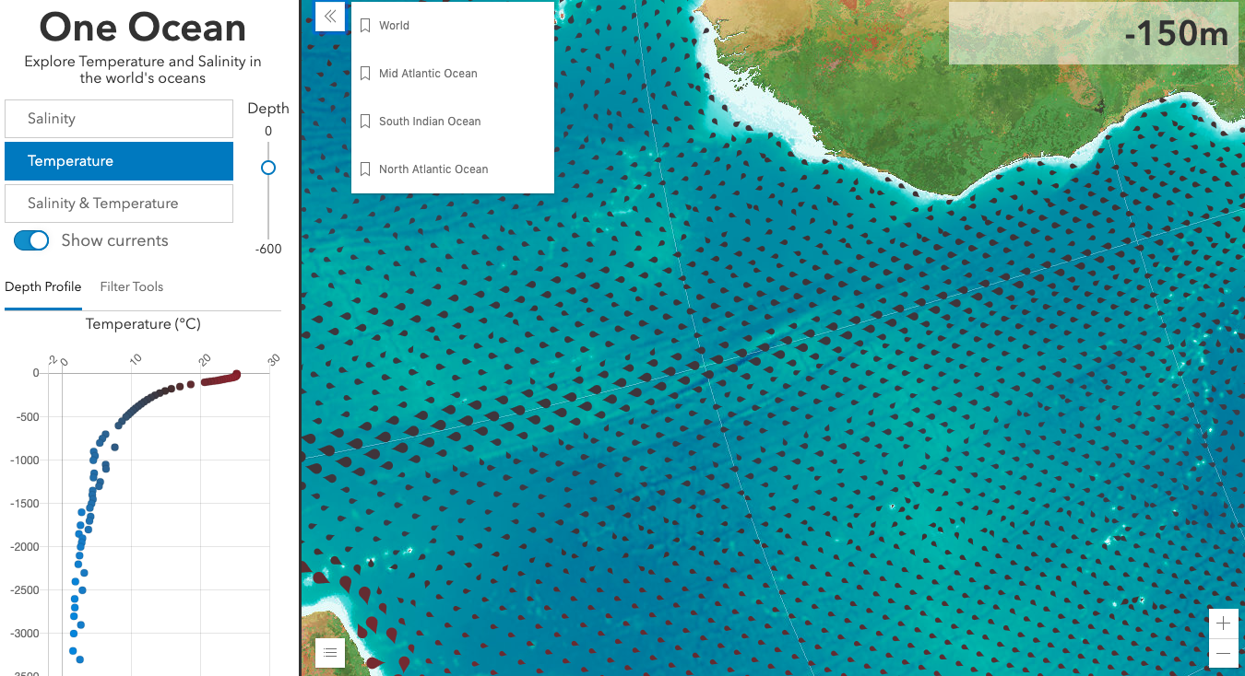
[zoom to Mid Atlantic Ocean]
[Slide the depth slider]
As I zoom in, you’ll notice the size of the icons grows so I can get a better view of the direction of flow.
Notice how fast the renderer updates as I update the depth…all these variables change instantly. I can even see how not only the temperature and speed of the currents changes as you drop in depth, but the direction also changes in the same x/y locations as you go deeper.

Slide 21
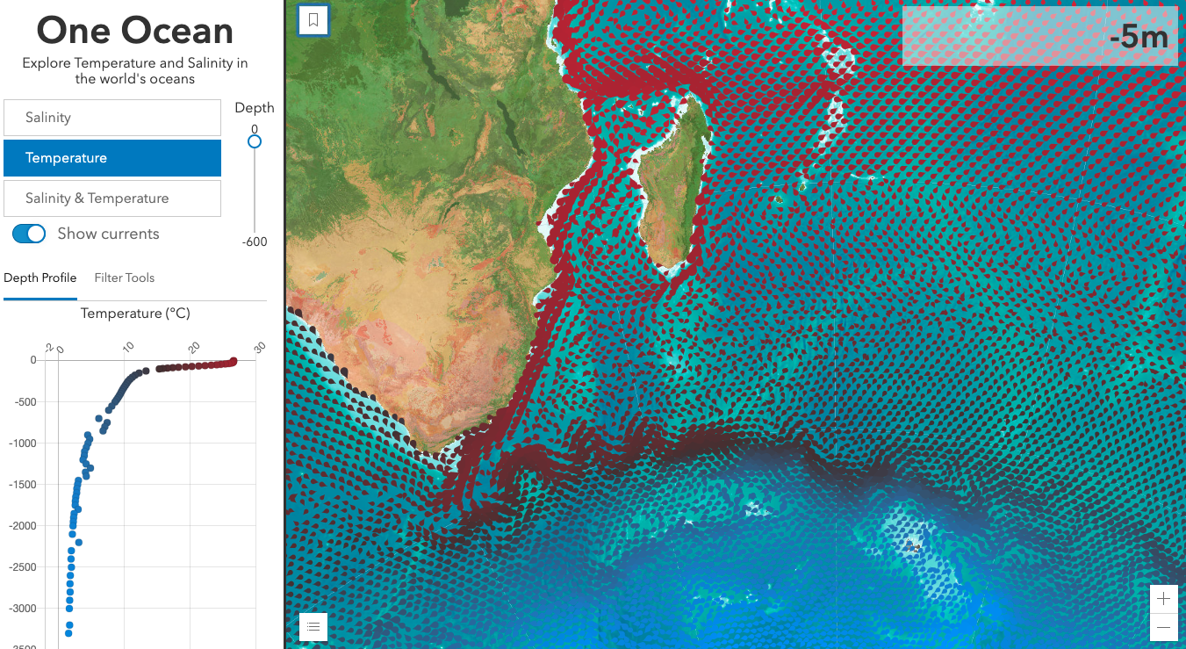
Let’s move to where the South Indian Ocean meets the Southern Ocean. I can see an area where a warm current meets cold water.

Slide 22
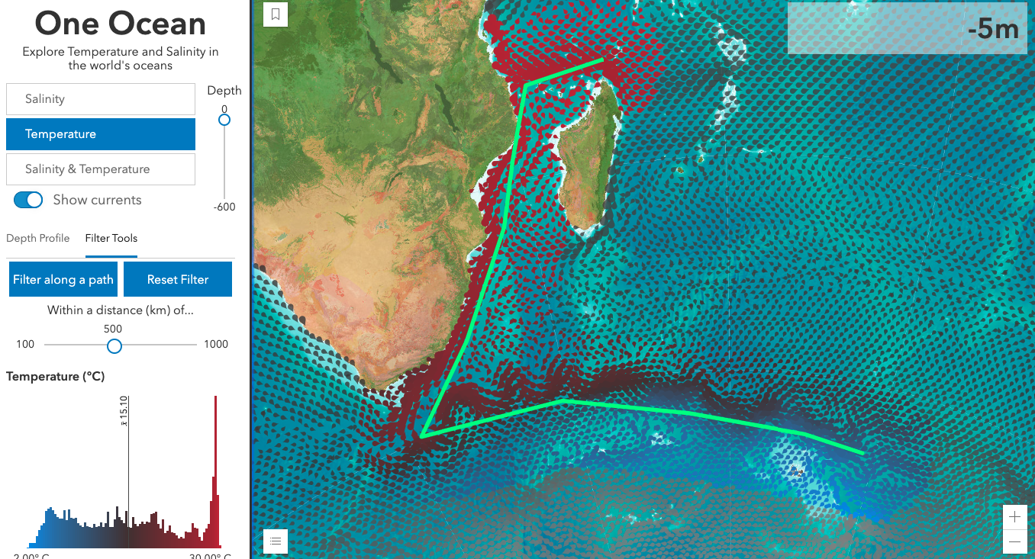
I want to view a smaller area of my data. I added a tool that allows the user to sketch a path and query all data within a distance of that path.
As they draw the path, the app generates a histogram, whose colors match the values of the points for that depth.

Slide 23
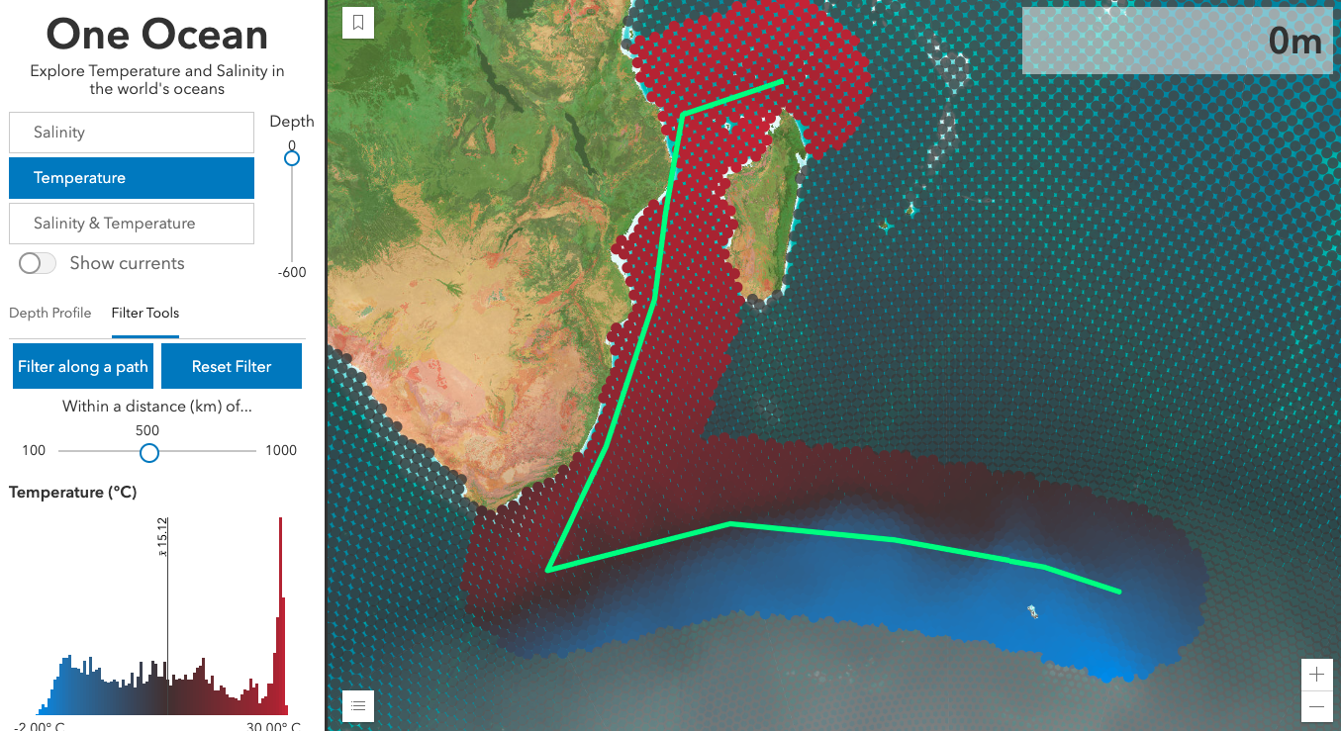
I set a filter on the data and style the points excluded from the filter with a feature effect, to subdue them. That way I can still see there’s data in those locations, but they aren’t of concern in my analysis.

Slide 24
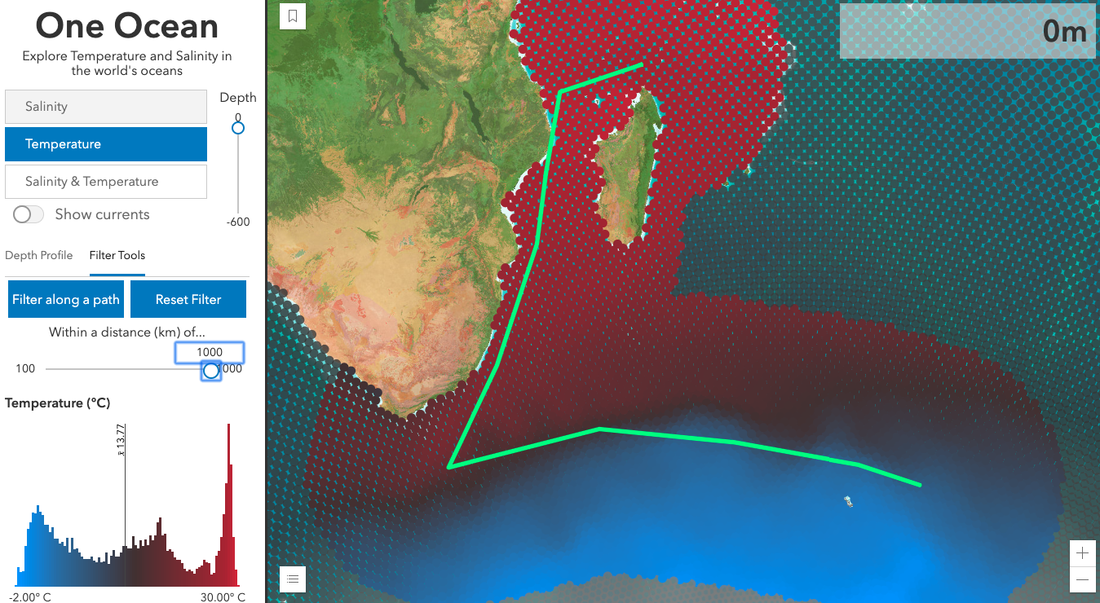
As the user increases or decreases the distance, and changes the desired depth, both the filter and the histogram instantly update without flashing, making this a smooth experience for the user.

Slide 25
Conclusion
As I’ve showed you this app, I hope you’ve caught the vision of how web mapping is evolving. It’s no longer about static presentation-style apps with a simple popup. Thanks to the vast performance improvements made over the last year, you can now bring more data to the browser more efficiently than ever before so you can build powerful, interactive apps for client-side data exploration and analytics.

